Slide 1

Mini Project-I (K24MCA18P) Odd Semester Session 2024-25
MINDFUL MOMENTS
Team Leader -Suchita Singh(2426mca2494)
Team Member- Shweta Patel (2426mca709 )
Project Supervisor:
Miss. Divya Singhal
Assistant Professor

Slide 2
Content
Introduction (1 slide)
Literature Review (2 slides)
Objective of the Project (1 slide)
Technology
Hardware Requirements (Development Environment, Server requirement (if required), Client requirement (if required).
Software Requirements (Language and Platforms like Frameworks, VS code, Android Studio and Jupyter notebook etc. )
Modules (2-3 slides)
Workflow (1 slide)
Reports (For Example: Project : Student Monitoring System, so reports like: Student Marks, Subjects, companies visit, and student appears in placement etc.)
References (1 slide)
Notes:
Font Styles: Times New Roman + Font Size: 25

Slide 3

Introduction
Mindful Moments: A Mindful Living Website
Mindful Moments is a website designed to help individuals cultivate mindfulness in their daily lives. It offers a variety of resources, including guided meditations, articles, and tips, to promote a sense of calm and well-being.

Slide 4

Literature Review
1
Mindfulness Research
2
Mindful Living Websites
The literature review explored various research studies and findings on the benefits of mindfulness practices.
An analysis of existing mindful living websites was conducted to identify best practices and user experience strategies.
3
User Needs & Preferences
The research aimed to understand the target audience's needs, preferences, and expectations for a mindful living website.

Slide 5
Objective of the Project
Promote Mindfulness:-To provide accessible resources for individuals seeking to integrate mindfulness into their lives.
Enhance Well-being:-To support users in cultivating a greater sense of calm, focus, and emotional well-being.
Improve User Experience:-To create a user-friendly website that offers a positive and engaging experience.

Slide 6
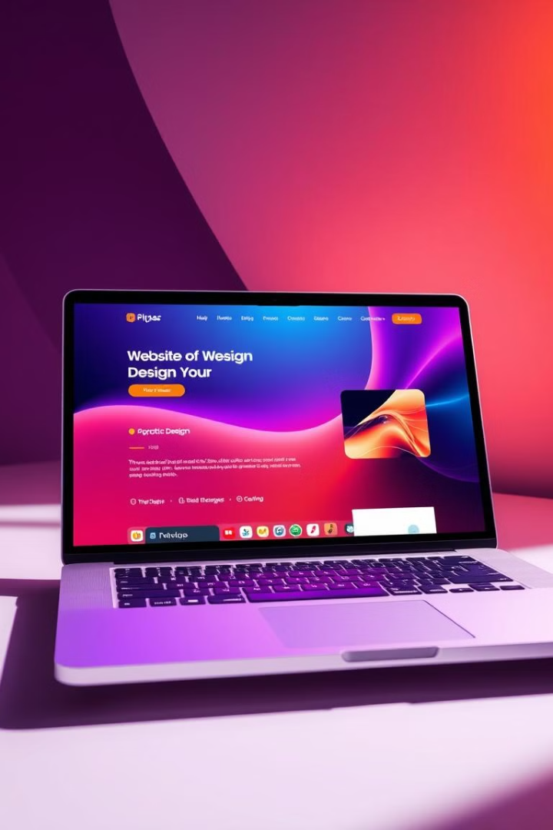
Technology
Hardware
Software
Personal Computer (PC) or Laptop
To include the backend framework
(e.g., Django (Python)and
Database (e.g., MySQL)
Sufficient storage and memory
Vs code platform
Web Browser (e.g., Chrome, Firefox)
Programming Languages (e.g., HTML, CSS, JavaScript,)

Slide 7
Modules
Homepage :
Introduction to the website, with a brief overview of its purpose, features, and benefits.
Meditation Library :
A collection of guided meditations on various topics, including stress reduction, sleep improvement, and self-compassion.
Mindfulness Articles
:
Articles, blog posts, and other content providing information and insights on mindful living practices.

Slide 8
In this we will provide the user with different kind of activities related to their problem.
Mindfulness Activities
:
Feedback by user
User can provide with the content or any other features they want and can share their experiences .
:
User Authentication :
(Login/Signup) and feedback storage in the backend.

Slide 9
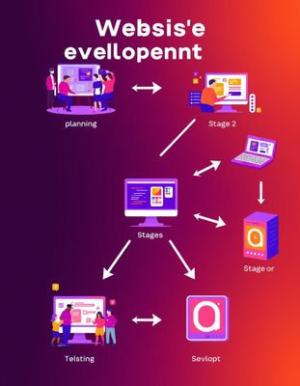




Workflow
Planning & Design(1-2weeks)
Defining the website's purpose, target audience, and features.
Development (3-7 weeks)
Coding the website using HTML, CSS, and JavaScript.
Testing & Deployment (8-9 weeks)
Ensuring the website functions correctly and is optimized for user experience.
Maintenance & Updates (10-11weeks)
Regularly updating content, fixing bugs, and improving performance.

Slide 10

Reports
Website Traffic
Track the number of visitors to the website and their behavior on the site.
User Engagement
Measure user interaction with the website's content, such as time spent on pages, clicks, and downloads.
User Feedback
Collect user feedback through surveys, comments, and contact forms to understand their experiences and identify areas for improvement.

Slide 11

References
References
YouTube
Channel Example: The Mindfulness Meditation Channel
Coursera
Website: coursera.org
Zenner, C., et al. (2014).
Mindfulness-Based Programs for Children and Adolescents: A Systematic Review and Meta-Analysis. In: Journal of Child Psychology and Psychiatry, 55(3), 197-206.

